Slide 1
Fairness and Bias in NLP- Part 1
Dr. Debashish Das

Slide 2
What We Will Cover?
A Carton of ML (NLP) Pipeline
Motivate Example: Conference Resolution
Wino-Bias Data
Gender bias in Coref System
Misrepresentation and Bias Stereotypes
Bias in Wikipedia
Bias in Language Generation
Representational Harm in NLP
Implicit association test (IAT)
Word Embedding Association Test (WEAT)
Beyond Gender & Race/Ethnicity Bias
Linear Discriminative Analysis (LDA)
Unequal Treatment of Gender
Biases in NLP Classifiers/Taggers
Control Biases: Debiasing, Data Augmentation

Slide 5
Can we Extend the Analysis beyond Binary Gender?

Slide 6
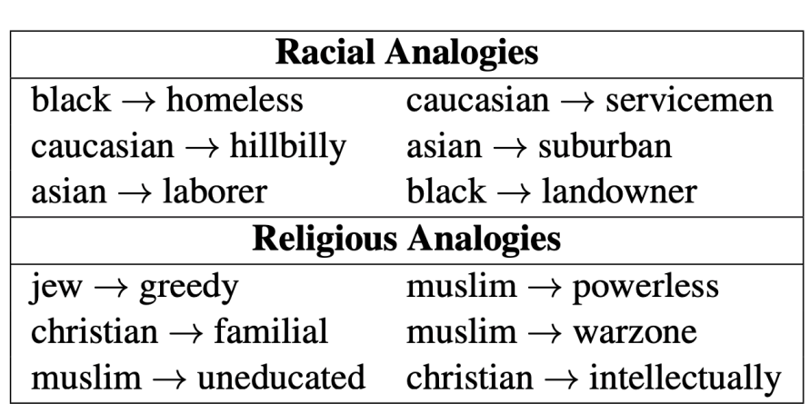
Beyond Gender & Race/Ethnicity Bias
Biases in word embeddings trained on the Reddit data from US users.
Manzini et al. NAACL 2019

Slide 7
How about other Embedding?

Slide 8
How about other Embedding?
Language with grammatical gender
Morphological agreement
(Zhou et al, EMNLP 2019)

Slide 9
Linear Discriminative Analysis (LDA)
Identify grammatical gender direction

Slide 13
How about bilingual embedding?
(Zhou et al, EMNLP 2019)

Slide 14
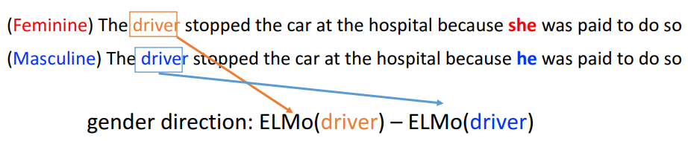
How about Contextualized Representation?
Gender Bias in Contextualized Word Embeddings
-First two components explain more variance than others
(Zhou et al, EMNLP 2019)

Slide 15
Unequal Treatment of Gender
Classifier

Slide 16
Unequal Treatment of Gender (Cont.)

Slide 17
Coreference with contextualized embedding
ELMo boosts the performance
However, enlarge the bias (Δ)

Slide 18
Does such Bias do “Harm” Certain People?

Slide 19
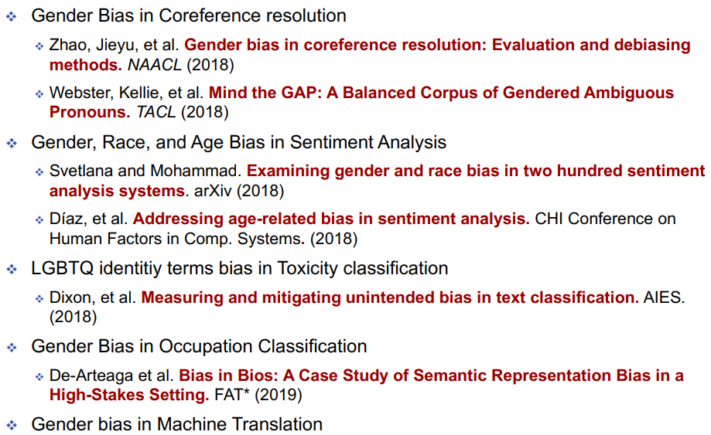
Biases in NLP Classifiers/Taggers
Prates, et al. Assessing gender bias in machine translation: a case study with Google Translate. Neural Computing and Applications (2018)

Slide 21
Examples of Harm from NLP Bias
Prevent Allocative Harm in Sensitive Applications
Swinger et al. (2019)

Slide 22
Can we Remove/Control these biases?
Swinger et al. (2019)

Slide 23
Towards Debiasing
Identify gender subspace: B
Identify gender-definitional (S) and gender-neutral words (N)
Apply transform matrix (T) to the embedding matrix (W)
a. Project away the gender subspace B from the gender- neutral words N
b. But, ensure the transformation doesn’t change the embeddings too much
Bolukbasi et al. (2016)

Slide 24
Make Gender Information Transparent in Word Embedding
Learning Gender-Neutral Word Embeddings [Zhao et al; EMNLP18]

Slide 25
Make Gender Information Transparent in Word Embedding (Cont.)
Learning Gender-Neutral Word Embeddings [Zhao et al; EMNLP18]

Slide 26
Make Gender Information Transparent in Word Embedding (Cont.)
Learning Gender-Neutral Word Embeddings [Zhao et al; EMNLP18]

Slide 27
Gender bias in Coref System

Slide 28
Is Gender Information Actually Removed from Embedding?

Slide 29
Completely removing bias is hard
Number of male neighbors for each occupation x-axis: original bias

Slide 30
Completely removing bias is hard (Cont.)
Number of male neighbors for each occupation x-axis: original bias

Slide 31
Should We Debias Word Embedding?
Awareness is better than blindness (Caliskan et. al. 17)

Slide 32
Wino-Bias Data
Stereotypical Dataset:
Anti-Stereotypical Dataset:

Slide 33
Data Augmentation-- Balance the data
Gender Swapping -- simulate sentence in opposite gender

Slide 34
Reduce Bias via Data Augmentation in
Coreference Resolution

Slide 35
Various Biases are embedded in NLP models
Controlling Biases is still an open problem

Slide 36
Further Readings
Subramonian, A. (2021, June). Fairness and Bias Mitigation: A practical guide into the AllenNLP Fairness module (https://guide.allennlp.org/fairness)
Talat, Z., Névéol, A., Biderman, S., Clinciu, M., Dey, M., Longpre, S., ... & Van Der Wal, O. (2022, March). You Reap What You Sow:
On the Challenges of Bias Evaluation Under Multilingual Settings. (https://aclanthology.org/2022.bigscience-1.3.pdf)
Sun, T., Gaut, A., Tang, S., Huang, Y., ElSherief, M., Zhao, J., Mirza, D., Belding, E., Chang, K.W. and Wang, W.Y., 2019. Mitigating gender bias in natural language processing: Literature review. arXiv preprint arXiv:1906.08976.
Linguistics 575: Societal Impacts of NLP (https://faculty.washington.edu/ebender/2021_575/)
Blodgett, S.L., Barocas, S., Daumé, H., & Wallach, H. (2020). Language (Technology) is Power: A Critical Survey of "Bias" in NLP. ACL.

Slide 37
Further Readings
Chang, K.W., Ordonez, V., Mitchell, M., Prabhakaran, V (2019). Tutorial: Bias and Fairness in Natural Language Processing. EMNLP 2019.
•Rathore, A., Dev, S., Phillips, J.M., Srikumar, V., Zheng, Y., Yeh, C., Wang, J., Zhang, W., & Wang, B. (2021). VERB: Visualizing and Interpreting Bias Mitigation Techniques for Word Representations. ArXiv, abs/2104.02797.
Dev, S., Sheng, E., Zhao, J., Sun, J., Hou, Y., Sanseverino, M., Kim, J., Peng, N., & Chang, K. (2021). What do Bias Measures? ArXiv, abs/2108.03362.
Dev, S., Monajatipoor, M., Ovalle, A., Subramonian, A., Phillips, J.M., & Chang, K. (2021). Harms of Gender Exclusivity and Challenges in Non-Binary Representation in Language Technologies. ArXiv, abs/2108.12084.

